Slide 1
Conjoinability of Regular n-gons
Hexagonal Resonance & Adaptive Geometry
Muhammad Zaid Bilal
ERP 30506
Discrete Mathematics • May 2026

Slide 2
Defining Conjoinability
What is k(n)?
k(n) is the maximum number of congruent regular n-gons that can be conjoined around a central n-gon Pᶜ in a valid planar configuration.
(i) Planarity
(ii) Vertex Adjacency
All polygon interiors are pairwise disjoint in the Euclidean plane.
Each polygon in S shares at least one vertex with Pᶜ.
(iii) Edge Alignment
(iv) Connectivity
At shared vertices, all incident edges are collinear.
The intersection graph of polygons is connected.
Vertex Skipping s(n): The minimum vertices skipped on each conjoined polygon (relative to neighbors on Pᶜ) required to maintain planarity.

Slide 3
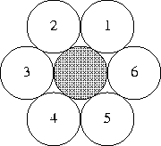
Existing Parallel – 2D Kissing Number
The maximum 2D kissing number—the number of non-overlapping unit circles that can simultaneously touch a central unit circle—is exactly 6. This configuration is achieved by arranging six circles in a hexagonal pattern around the central circle. It is a proven, trivial result in 2D geometry.

Slide 4
Empirical Data (n = 3 to 41)
n = 3–6
k(n) = n, s(n) = 0 (natural fit)
n = 7–35
k(n) oscillates 4–5, s(n) grows
n = 36 ★
k(36) = 6! s(36) = 4 — Hexagonal Resonance
n ≥ 34
Multiple placements (positional isomers) emerge
Maximally Tense
n = 13, 19, 24, 29, 36 — critical tension states

Slide 5
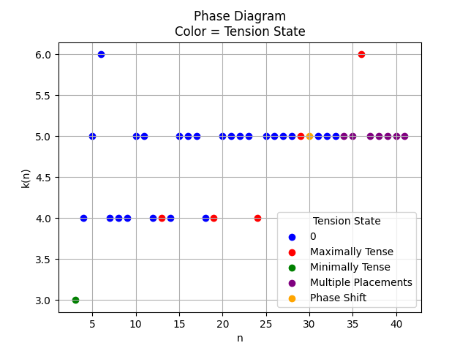
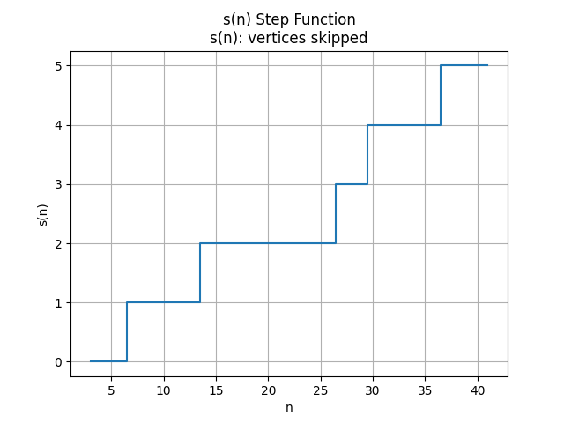
Key visualizations
geogebra.org/m/tdxwtpnv

Slide 6
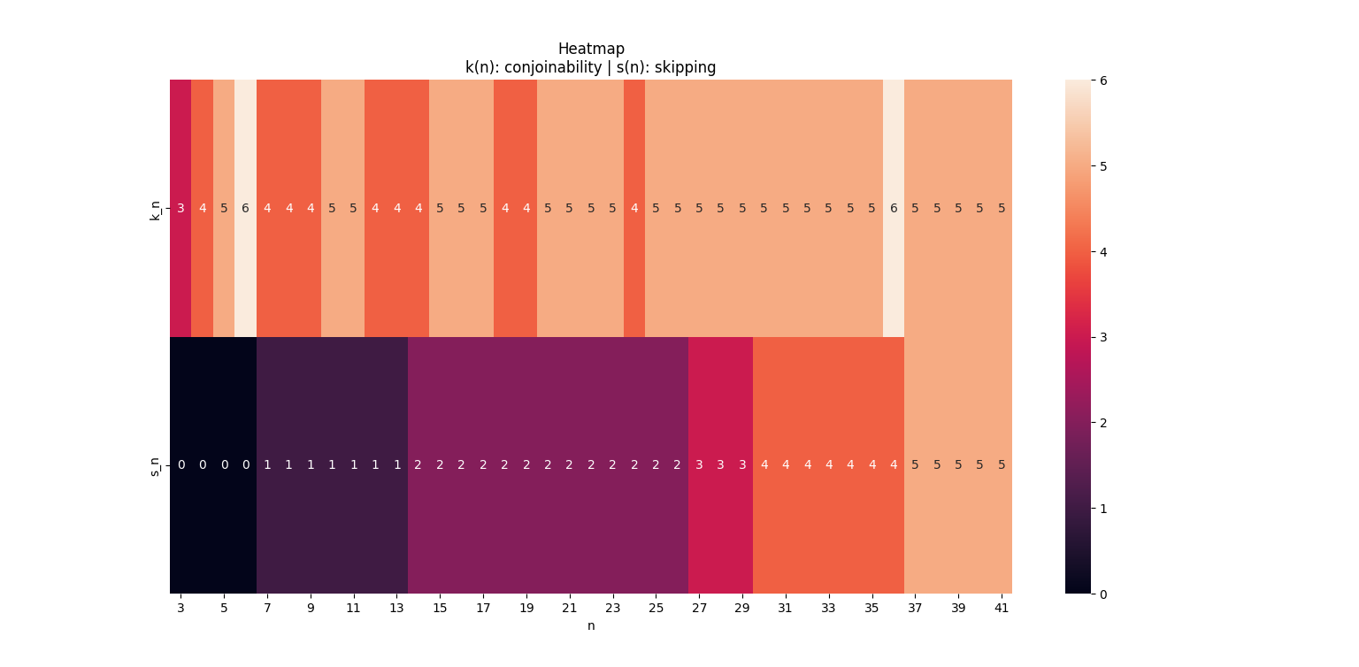
Key visualizations

Slide 7
Key visualizations
https://jupyter.org/try-jupyter/notebooks/?path=Vertex_Conjoinability.ipynb

Slide 8
Key visualizations
import pandas as pd
import matplotlib.pyplot as plt
import numpy as np
import math
import seaborn as sns
import plotly.graph_objects as go
# ─────────────────────────────────────────────
# DATASET
# ─────────────────────────────────────────────
data = [
[3,3,"No",0,"π/3","Minimally Tense"],
[4,4,"No",0,"π/2","0"],
[5,5,"No",0,"3π/5","0"],
[6,6,"No",0,"2π/3","0"],
[7,4,"Yes",1,"5π/7","0"],
[8,4,"Yes",1,"3π/4","0"],
[9,4,"Yes",1,"7π/9","0"],
[10,5,"Yes",1,"4π/5","0"],
[11,5,"Yes",1,"9π/11","0"],
[12,4,"Yes",1,"5π/6","0"],
[13,4,"Yes",1,"11π/13","Maximally Tense"],
[14,4,"Yes",2,"6π/7","0"],
[15,5,"Yes",2,"13π/15","0"],
[16,5,"Yes",2,"7π/8","0"],
[17,5,"Yes",2,"15π/17","0"],
[18,4,"Yes",2,"8π/9","0"],
[19,4,"Yes",2,"17π/19","Maximally Tense"],
[20,5,"Yes",2,"9π/10","0"],
[21,5,"Yes",2,"19π/21","0"],
[22,5,"Yes",2,"10π/11","0"],
[23,5,"Yes",2,"21π/23","0"],
[24,4,"Yes",2,"11π/12","Maximally Tense"],
[25,5,"Yes",2,"23π/25","0"],
[26,5,"Yes",2,"12π/13","0"],
[27,5,"Yes",3,"25π/27","0"],
[28,5,"Yes",3,"13π/14","0"],
[29,5,"Yes",3,"27π/29","Maximally Tense"],
[30,5,"Yes",4,"14π/15","Phase Shift"],
[31,5,"Yes",4,"29π/31","0"],
[32,5,"Yes",4,"15π/16","0"],
[33,5,"Yes",4,"31π/33","0"],
[34,5,"Yes",4,"32π/34","Multiple Placements"],
[35,5,"Yes",4,"33π/35","Multiple Placements"],
[36,6,"Yes",4,"34π/36","Maximally Tense"],
[37,5,"Yes",5,"35π/37","Multiple Placements"],
[38,5,"Yes",5,"36π/38","Multiple Placements"],
[39,5,"Yes",5,"37π/39","Multiple Placements"],
[40,5,"Yes",5,"38π/40","Multiple Placements"],
[41,5,"Yes",5,"39π/41","Multiple Placements"]
]
df = pd.DataFrame(data, columns=[
"n","k_n","vertex_skip","s_n","angle_str","tension"
])
# ─────────────────────────────────────────────
# DERIVED VARIABLES
# ─────────────────────────────────────────────
df["angle_rad"] = (df["n"] - 2) * math.pi / df["n"] # θ(n)
df["delta"] = math.pi - df["angle_rad"] # distance from circle
# Flags
df["is_max_tense"] = df["tension"].str.contains("Maximally", na=False)
df["is_phase"] = df["tension"].str.contains("Phase", na=False)
df["is_isomer"] = df["tension"].str.contains("Multiple", na=False)
# ─────────────────────────────────────────────
# 1. CORE GRAPH (MOST IMPORTANT)
# k(n) vs n
# ─────────────────────────────────────────────
plt.figure()
plt.plot(df["n"], df["k_n"], marker='o')
# highlight resonance
res = df[df["k_n"] == 6]
plt.scatter(res["n"], res["k_n"])
plt.title("k(n) vs n\nk(n): max polygons | n: vertices")
plt.xlabel("n (number of vertices)")
plt.ylabel("k(n) (conjoinability)")
plt.grid()
plt.show()
# ─────────────────────────────────────────────
# 2. STEP FUNCTION (s(n))
# ─────────────────────────────────────────────
plt.figure()
plt.step(df["n"], df["s_n"], where='mid')
plt.title("s(n) Step Function\ns(n): vertices skipped")
plt.xlabel("n")
plt.ylabel("s(n)")
plt.grid()
plt.show()
# ─────────────────────────────────────────────
# 3. PHASE DIAGRAM (DYNAMIC SLIDER OVER n)
# ─────────────────────────────────────────────
import plotly.express as px
color_map = {
"0": "blue",
"Minimally Tense": "green",
"Maximally Tense": "red",
"Phase Shift": "orange",
"Multiple Placements": "purple"
}
df["color"] = df["tension"].map(color_map)
fig = px.scatter(
df,
x="n",
y="k_n",
color="tension",
color_discrete_map=color_map,
animation_frame="n", # 👈 SLIDER CONTROL
range_x=[df["n"].min(), df["n"].max()],
range_y=[df["k_n"].min()-1, df["k_n"].max()+1],
title="Phase Diagram (Animated over n)"
)
fig.update_traces(marker=dict(size=10))
fig.update_layout(
xaxis_title="n",
yaxis_title="k(n)",
)
fig.show()
# ─────────────────────────────────────────────
# 4. HEATMAP
# ─────────────────────────────────────────────
heat = df[["n","k_n","s_n"]].set_index("n").T
plt.figure()
sns.heatmap(heat, annot=True)
plt.title("Heatmap\nk(n): conjoinability | s(n): skipping")
plt.show()
# ─────────────────────────────────────────────
# 5. IMPORTANT RELATION
# k(n) vs s(n)
# ─────────────────────────────────────────────
plt.figure()
plt.scatter(df["s_n"], df["k_n"])
for i, row in df.iterrows():
plt.text(row["s_n"], row["k_n"], str(row["n"]), fontsize=7)
plt.title("k(n) vs s(n)\nRelation between skipping and packing")
plt.xlabel("s(n)")
plt.ylabel("k(n)")
plt.grid()
plt.show()
# ─────────────────────────────────────────────
# 6. ZOOM (n=30–40)
# ─────────────────────────────────────────────
subset = df[(df["n"] >= 30) & (df["n"] <= 40)]
plt.figure()
plt.plot(subset["n"], subset["k_n"], marker='o')
plt.axvline(36)
plt.text(36, 6.1, "n=36")
plt.title("Zoom: Resonance Region")
plt.xlabel("n")
plt.ylabel("k(n)")
plt.grid()
plt.show()
# ─────────────────────────────────────────────
## ─────────────────────────────────────────────
# 7. INTERACTIVE 3D (WITH TENSION LABELS)
# ─────────────────────────────────────────────
# Map tension states to readable colors
color_map = {
"0": "blue",
"Minimally Tense": "green",
"Maximally Tense": "red",
"Phase Shift": "orange",
"Multiple Placements": "purple"
}
# Assign colors
df["color"] = df["tension"].map(color_map)
fig = go.Figure()
for tension_state in df["tension"].unique():
subset = df[df["tension"] == tension_state]
fig.add_trace(go.Scatter3d(
x=subset["n"],
y=subset["angle_rad"],
z=subset["k_n"],
mode='markers',
name=tension_state, # 👈 THIS creates legend labels
marker=dict(
size=6,
color=subset["color"].iloc[0],
opacity=0.8
),
text=subset["tension"]
))
fig.update_layout(
title="Interactive 3D: (n, θ(n)) → k(n) with Tension States",
scene=dict(
xaxis_title="n (vertices)",
yaxis_title="θ(n) internal angle",
zaxis_title="k(n) conjoinability"
)
)
fig.show()

Slide 9
The Open Problem
Hexagonal Resonance Conjecture:
Prove that k(n) = 6 if and only if n = 6ᵐ for m ∈ ℕ, m ≥ 1.
If other n yield k(n) = 6, fully characterize that set.
Why it's hard:
Internal angle of n-gon → (n−2)π/n approaches π non-uniformly
Vertex skipping s(n) is non-monotonic and interacts with k(n) in complex ways
n = 36 achieves k = 6 while being 'Maximally Tense' — counter-intuitive
No closed-form for s(n) is known; pattern breaks periodically

Slide 10
Five Formal Hypotheses
H1 Hexagonal Resonance
k(n) = 6 iff n = 6ᵐ. These n-gons periodically recapture the 2D kissing number of a circle.
H2 Vertex Skipping Optimization
s(n) is an active optimization strategy. Maximally Tense states trigger non-monotonic adjustments to maintain k(n).
H3 Generating Function Isomorphism
A function P(x,y) exists with coupled recurrences (analogous to Yeh's polyene model) that reproduces k(n) and s(n) for all n.
H4 Tense Perfectibility
k(36) = 6 occurs under maximal angular pressure — these adaptive states differ fundamentally from the unconstrained k(6) = 6.
H5 Discrete-to-Continuous Resonance
The system acts as a 'geometric wave function': 6-fold symmetry of the circle intermittently manifests in discrete n-gons at resonance points.

Slide 11
Positional Isomers: Emergence at n = 34
What are positional isomers?
For n ≥ 34, a given (k, s) pair admits multiple geometrically distinct valid configurations — analogous to structural isomers in chemistry where the same formula yields different molecular shapes. The count m(n) measures how many such configurations exist.
Why does it start at n = 34?
Isomer data (from spreadsheet):
At n = 34, the internal angle (32π/34 ≈ 169.4°) combined with s(n) = 4 opens enough angular slack that the 5 surrounding polygons can occupy non-equivalent vertex positions on Pᶜ — geometrically impossible for smaller n where angles are tighter.
n | k(n) | s(n) | Notes
34 | 5 | 4 | 2 placements
35 | 5 | 4 | 2 placements
36 | 6 | 4 | 1 — Maximally Tense
37–41 | 5 | 5 | 2+ placements
Chemistry Parallel (Yeh 2003): Just as acyclic conjugated polyenes yield multiple structural isomers, n-gon configurations for n ≥ 34 show positional isomerism. The count m(n) is conjectured to grow analogously to Yeh's polyene isomer sequences (Hypothesis H3).
Key insight at n = 36: Despite being Maximally Tense, n = 36 achieves k = 6 with m(36) = 1 — a single, unique configuration. Angular tension resolves into perfect hexagonal symmetry rather than isomeric multiplicity.

Slide 12
Line of Attack
Phase 1 · Empirical & Computational
k(36) = 6 Visualization
1
Python (Shapely) to extend dataset to n = 250+. Matplotlib plots of k(n), s(n), m(n). Compute k(216) to test H1. Enumerate isomers m(n) for n ≥ 34.
geogebra.org/m/tdxwtpnv
Phase 2 · Mathematical
2
Formalize generating function P(x,y) with Yeh-style recurrences. Derive closed-form s(n). Study group symmetries of 6ᵐ-gons.
36-gon · s(36) = 4 · k = 6
Python Toolkit
Phase 3 · Theory & Publication
shapely — polygon geometry & overlap
matplotlib — plot k(n), s(n), m(n) to n = 250+
itertools — enumerate valid configs / isomers
3
Connect to ergodic theory / quasicrystals. Prove or disprove H1. Submit to arXiv (math.CO / math.MG).
Immediate test: Compute k(216). If k(216) = 6 ⟹ H1 validated.

Slide 13
References
[1] Yeh, C.-Y. (2003). A mathematical problem in isomerism and radicality of acyclic conjugated polyenes. Journal of Mathematical Chemistry, 34(1–2), 95–110.
→ Parallel: coupled generating functions S(x,y)/D(x,y); polyene isomers ↔ polygon isomers at n≥34
[2] Torda, M., Goulermas, J.Y., Kurlin, V., Day, G.M. (2022). Densest plane group packings of regular polygons. arXiv:2207.08959 [math.MG].
→ Parallel: n=36 achieves disc-like symmetry in plane groups; density oscillation ↔ k(n) oscillation
[3] Conway, J.H. & Torquato, S. (2006). Packing, tiling, and covering with tetrahedra. Proceedings of the National Academy of Sciences, 103(28), 10612–10617.
→ Parallel: dihedral angle constraint ↔ internal angle pressure; clump packing ↔ vertex skipping
[4] Kuperberg, G. & Kuperberg, W. (1990). Double-lattice packings of convex bodies in the plane. Discrete & Computational Geometry, 5, 389–397.
→ Background: double-lattice (p2 group) as optimal base for polygon packing
[5] Hales, T.C. (2005). A proof of the Kepler conjecture. Annals of Mathematics, 162, 1065–1185.
→ Background: densest sphere packing — motivates question of optimal polygon conjoinability

